Slide 1
Tech Modernization
2021 and Beyond …
Wealth Management
December 2020

Slide 2
“Technology Principles” to execute on our strategy
Unified customer experience: Deliver unified experience across all our businesses/products (rather than product-specific experiences), with the objective of maximizing customer engagement
APIs: Applications and customer experiences will access data and services only via our published APIs and microservices. These “open banking APIs” will be used for both internal and external uses. All APIs will be documented, published, discoverable, and will comply with our API standards
Re-use of shared services, APIs: Applications and customer experiences will leverage shared, reusable services and APIs for common set of services like authentication, money movement, on-boarding and document management
Unified data layer & infrastructure: All data access by applications, customer experiences and analytics uses will use data APIs on the unified data platform. These APIs will provide data of record, without need for redundant copies of data. We will reduce, eliminate unnecessary copies of data
Cloud-first: All new applications to be deployed on AWS or Google Cloud. We do not intend to add hardware or systems to the on-premise data centers and will limit mainframe expansion.
Open source: Applications, customer experiences and other users will leverage open source tools and software wherever possible
Hollow out the core: The core systems like Hogan should only be used to fulfill their primary purpose as systems of record. Data and processing not relevant to their primary purpose will be moved out of the core. Applications will use shared services or data APIs, rather than directly accessing core systems
Resiliency: Each application, service and API will be designed & tested to be individually resilient and scalable. Our systems, in the Cloud and on-prem, will have an active-active resiliency configuration
Security and Risk Management: Systematically integrate security and risk management into our applications and development frameworks
Architectural rigor: Any exceptions to above principles need to be explicitly approved by Enterprise Architecture.
Notes:
Key Points:
Importance of 10 Technology Principles set within Dilip’s organization
WISE commitment to all principles; priority on highlighted 5

Slide 3
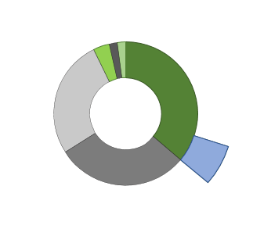

WEALTH MANAGEMENT API Engineering
NOV 2020
API Catalog | DevOps |  | Data Platform / Sprawl Reduction
461 Wealth API’s in Production 40% Modern stack / 60% Legacy 30% of API’s external 45% WMIS reusable 21% of API’s Enterprise re-usable | Engineering SLA for deployments reduced from 5 days to 1 hour 100% all new API development deployed via CI/CD pipelines 100% of all new API’s have automated tests written in 2020 500+ pipeline deployments in 2020 (DEV, IT, UAT, PRD) |  | Reduced MIPS – US Bank Mobile App & data aggregators use Wealth API’s sourcing data from Cassandra. (Impacts Hogan CIS and FIS) 15 data streaming services built to populate Online/Cassandra data stores 13 Online/Cassandra tables built 10 API’s sourcing data from Online/Cassandra
 | Public Cloud Readiness |  | Workforce
 | 100% of new API development is cloud-ready 0 API’s on public cloud 50 API’s available for public cloud deployment Migration to public cloud must align with Broad Stroke data modernization
Accomplishments |  | Next Steps
30% Production API increase; 100 net-new Production API’s in 2020 10% reduction in Technical Debt; 50 legacy API’s converted to modern stack APIs as Product as well as enabler; Product Model rollout Federated engineering model with core Enterprise platforms (Apigee, Cassandra, GraphQL) Diversified workforce sourcing across strategic vendors (WiPro, Cognizant, TCS) WM APIs strategy aligned with Data strategy |  | Expand API Catalog to include entire universe; increase reusability targets Expand external/partner API footprint by strengthening CDO product alignment Formalize Product Model with dedicated Technology Product Owner Reduce technical debt and align with Broad/Bold Stroke program (OSB, ESD, Mulesoft) Build out Wealth data sets in Online / Cassandra
Modern Stack
TIBCO BWCE: 9
Spring Boot: 18
Legacy
MuleSoft: 9
Apigee: 147
461
API’s
89% Engineers
77% Offshore contractors
17% FTE/FTC ratio
Engineering capacity increased 53% over 2019
Upgrading Engineering talent and cross-training Data & API staff
4 Product Model teams
Technology Product Ownership
TIBCO: 132
Onshore 23%
OSB: 146
Enterprise
Reusable
API’s per Product Group
Trust & Investment
Brokerage
Financial Planning
Banking
253
146
14
48

Slide 4
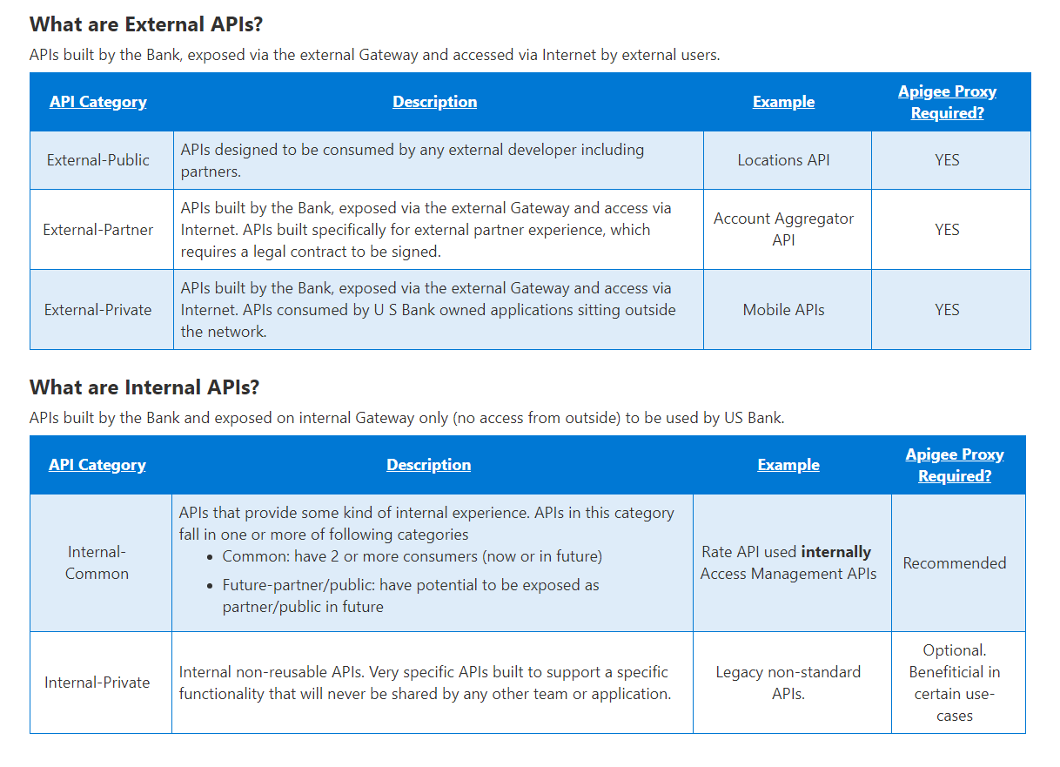
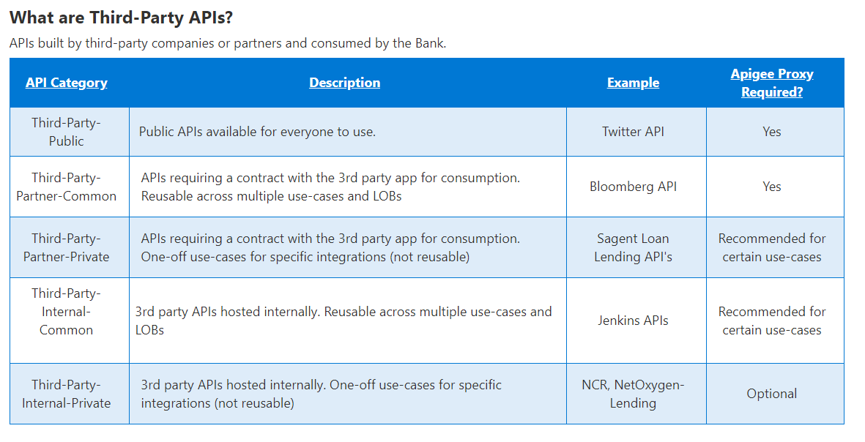
API Classification

Slide 5
API Proxies
Google Apigee: API Gateway
Exposes your services as managed APIs. Single entryway into a system; ensures reliable processing of every API call. Provides enterprise-grade security and central management of APIs
Dedicated infrastructure layer for facilitating service-to-service communications between microservices. An inter-service communication infrastructure.
Having such a dedicated communication layer can provide a number of benefits, such as providing observability into communications, providing secure connections, or automating retries for failed requests.
Google Istio: Service Mesh
PingFederate: Federation Server
Security layer; enables authentication and single sign-on
Oracle Service Bus (OSB) Enterprise Service Bus
Phasing out at US Bank

Slide 6
(Apigee) API Gateway: Exposes services as managed API’s
API Gateway Architecture
Single entryway into a system
Primary goal: ensure reliable processing of every API call.
“Edge” Proxy API services exposed to applications call downstream back-end microservices
Enforce network policies to connect, secure, encrypt, observe traffic.
Resiliency capabilities built-in: Circuit Breakers, Timeouts, Load Balancing/Failover
Built-in support for service discovery & analytics
API’s as a product
Apigee Est. 2009
Web Application
Mobile Application
3rd Party Application
API Gateway
Mediate
Secure
Composition
North/South
Transform
Meter
Error Handling
Throttle
Protocol
Caching
At the edge, you don’t control the client
The fundamental difference between edge routing (north/south) and internal (east/west) routing is that with the edge, you don’t control the client.
The client can make requests with arbitrary formats and types that need to be handled. Some examples:
    Supporting redirection from HTTP to HTTPS.
    Support for the X-Forwarded-For HTTP header
    Human to machine authentication via OAuth, OIDC, and the like.
    Many different ways of routing (regex routing, header-based routing, host header routing)
Service A
Service B
Service C

Slide 7
(Istio) Service Mesh: Network Communication Infrastructure
Primary Goal: Mitigate risk of microservice application failure.
Facilitates communication between microservices within a platform.
Takes logic governing service-to-service communication out of individual services and abstracts it to a layer of infrastructure.
Provides observability into communications, secure connections, automated retries of failed requests
Can document how well (or not) different parts of an app interact; allowing optimization and efficient app growth.
A given Microservice won’t directly communicate with the other microservices; requests are routed between microservices through proxies in their own infrastructure layer. Individual proxies that make up a service mesh are sometimes called “sidecars,” since they run alongside each service, rather than within them. Together, these “sidecar” proxies form a mesh network.
Easy deployment to Docker, Kubernetes.
API’s as pieces of atomic functionality.
Pattern Est. ~2017
Service Mesh Architecture
Service A
Service B
Service C
Service D
Service E
Service F
East / West

Slide 8
API Gateway vs Service Mesh
Web Application
Mobile Application
3rd Party Application
API Gateways (in general) focus on north/south traffic.
Service meshes handle east/west traffic.
Most organizations start with an API Gateway over a service mesh, because everyone needs an ingress solution, while not everyone needs a service mesh.
For many applications, API Gateways can provide much of the functionality that a service mesh provides.
API Gateway
Mediate
Secure
Composition
North/South
Transform
Meter
Error Handling
Throttle
Protocol
Caching
When considering an API Proxy…get your compass:
Using microservice architecture?
Will it be reused/shared within WMIS?
Will it be reused/shared across US Bank?
Will it be reused/shared externally?
Service A
Service B
Service C
Service D
Service E
Service F
East / West

Slide 9
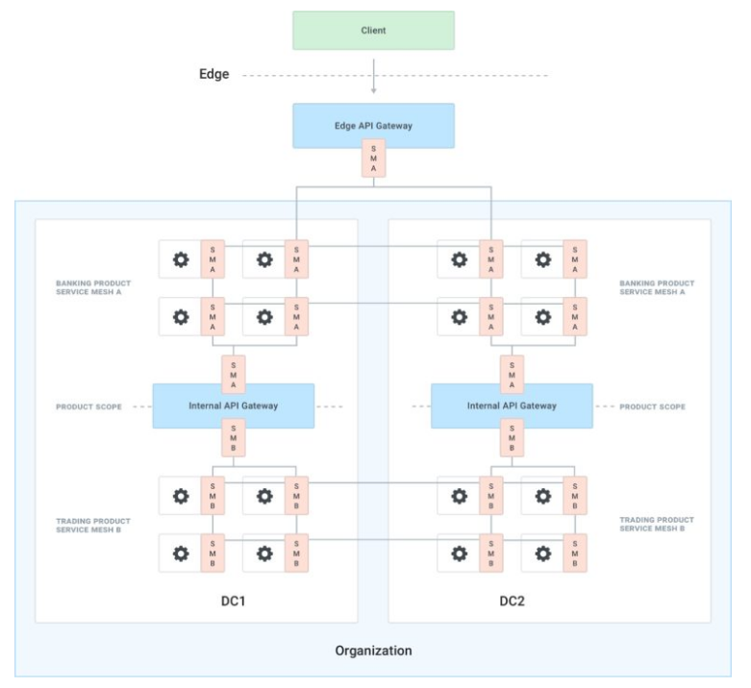
API Gateway & Service Mesh Implementation example: financial institution
Marco Palladino - https://konghq.com/blog/the-difference-between-api-gateways-and-service-mesh/

Slide 10

Authentication & Authorization – Granular Data Control within Reused/Shared API
Application Layer
User ID
Application 1
Application 2
Application 3
Entitlements
Active Directory
API Key
UserID
User Roles
Product Type(s)
API Key
UserID
User Roles
Product Type(s)
API Key
UserID
User Roles
Product Type(s)
API Request Payload
Trusted access to API granted via API keys
Application provides user credentials & entitlements
Application provides additional filters as needed
Trust Account Details API
(Apigee)
App examples:
App_1 COID_1
App_2 COID_2
App_3 COID_1, COID_3
Role examples:
Role_1 COID_1
Data Query
Application-specific filters (Product Type)
User role-based filtering (Role based security)
User input (Account#)
Wealth Security API
Taxlots Domain API
(Springboot)
Data Security Implementation
Taxlots Data API
(GraphQL)
Cassandra

Slide 11
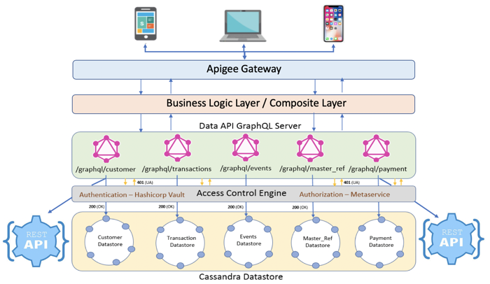
US Bank Online/Mobile API Stack
Smart Apply Data API’s
Apply Smart <1>
Wise APIGEE Proxy
GraphQL API <3>
Cassandra <4>
Apply will be sending the promotion code and cust lpid information.
Apigee proxy will be sending it to GraphQL API.
GraphQL is a mutation where it will upsert to Cassandra.
Data will be upsert to customer_datastore.mktg_prfl_by_lpid.
Service
/usb/customer-services/data/graphql-mutation/v1/graphql
Sample Request
Mutation
{
createMktgPrflByLpid
( custlpid: “327329382",
loadts: "2020-06-28 16:48:37", wbppromocde: "abcd" )
}

Slide 12
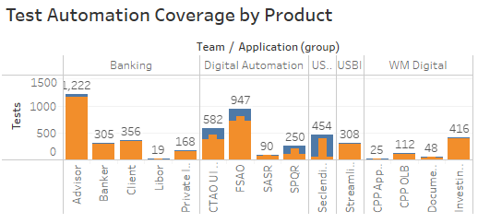
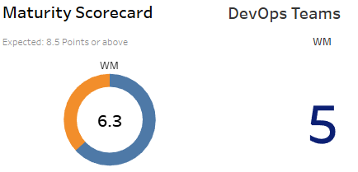
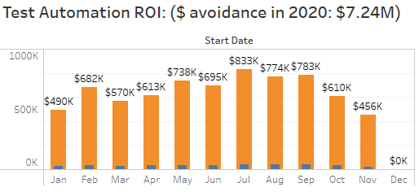
WEALTH MANAGEMENT Test Automation and DevOPS
NOV 2020
Test Automation | DevOps |  | Test Data
79% test automation coverage for inflight products. $7.24M in cost avoidance year-to-date. 11K manual testing hours saved in October | 5 Products with CI/CD established. Latest one was added in Oct. Maturity score trending upwards. 30% of tests are being executed on private cloud. 90% of tests are being executed using Jenkins pipeline. Process is fully automated from execution till reporting. |  | Test Data as a Service (TDaaS v3.0) released in October. Released 2 major enhancement around Brokerage Account conditioning and reservation. 130 total TDaaS users 5,400 TDaaS requests in between October and November
 | Public Cloud Readiness |  | 2021 and beyond…
 | Wealth Management products being built this year are using containerized workloads, deployed to Rancher, these are public cloud ready workloads. Identified candidate workloads for public cloud migration. Wealth Management product teams, continue to stay aligned with CAWG for Governance and Training. Wealth Management product teams, continue to target private cloud until enterprise controls and processes are in place |  | All Wealth Management products will transition to new CI/CD pipeline, which supports Pipeline-as-Code capabilities. The new pipeline would be multi-cloud capable. Wealth Management product teams have started doing technical proof-of-concepts to get better understanding of Pipeline-as-Code and multi-cloud deployments.
Accomplishments |  | Next Steps
Published a new Tech Modernization dashboard that includes Test Automation, Test Data, DevOps and WISE metrics on Tech Modernization SharePoint. Developed automated test report integration for .NetCore projects. Implemented Sauce Labs integration with U.S. Bank to mitigate risks for Mobile Development and Testing. TDaaS usage up 50% in comparison with September. Using containerized workloads which are public cloud ready. |  | Working on JavaScript visual testing solution. Working with few vendors to understand the capabilities of AI and ML in new Test Automation tools. TDaaS v4.0 release scheduled on 12/03 Candidates identified for Public Cloud migration as soon as enterprise controls and processes are in place.

Slide 13
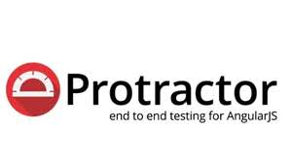




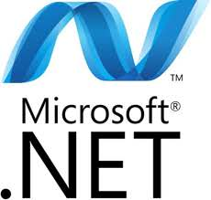


Achievements 2020
Test Automation and Governance
        Protractor JavaScript Framework: enabled responsive test design on web and mobile using same test automation code simplifying the process and saving substantial time.
        Rest-Assured: API testing in Java Framework decoupling API and UI tests to better align with Above/Below the glass approach and reusability of test components.
        Sauce Labs: Vendor solution implemented for Business Line and Software Engineers to help mitigate risks with mobile testing. A new lab environment has been set up.
        Private cloud: Migrated Selenium Grid to Rancher and Kubernetes for faster and parallel automated execution on US Bank Cloud.
        Tech Modernization: Created a dashboard as a single source of data to report Tech Modernization Metrics.
        Automated Test Reports: Java, JavaScript and .NetCore. Reports are automated and sent to the relevant team without any manual intervention.
        CI/CD pipeline: 5 teams are CI/CD enabled from code deployment, test automation to reporting.
        Visual Testing: Added Sikuli framework for Java for more robust testing to save time and cost.
        Performance Testing: JMeter set up completed for performance testing.

Slide 14

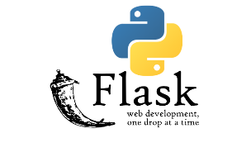
Achievements 2020
Test Data as a Service (TDaaS)
        Built ground up TDaaS Platform on Tech Modernization principles in a cloud agnostic approach. Each component of TDaaS is containerized and can be deployed to public cloud anytime.
        TDaaS UI components are built on ReactJS, an open-source JavaScript library.
        TDaaS follows microservice architecture for their RESTful API layer. TDaaS APIs are developed using Python Flask, a lightweight web application framework.
        TDaaS has adopted CI/CD practices to increase the velocity of code deployment and followed DevOps principles.

Slide 15
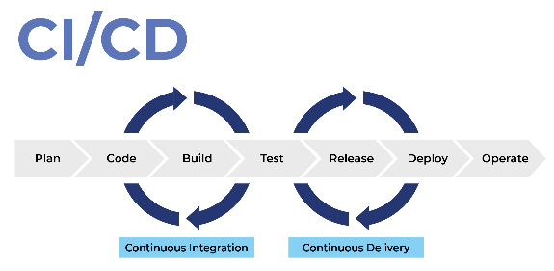
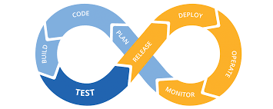
Looking forward in 2021!
CI/CD - DevOps
  Enable 90% of the teams to DevOps through automated code deployment, test automation and reporting.
  New automated tests to be created for Cloud-Based infrastructure (eliminate dependencies on-premise machines/servers) using U.S. Bank private cloud, Sauce Labs or any public cloud available.
Test Automation and Governance
  Implement Visual Testing for JavaScript framework.
  Spin up Performance testing infrastructure with Docker and JMeter and centralize best practices.
  Explore AI and ML based test automation tools to enhance testing framework to reduce costs, save time and deliver a better product (example EggPlant).
  Expand the API repositories.
  Use of available APIs to help automate the defect and reporting procedures.
  Enhance .Net Framework integration.
  Incorporate IS teams under WM Governance and Federate execution model.
  Learn and implement new technology/tools.

Slide 16


Looking forward in 2021!
Test Data as a Service (TDaaS)
        Salesforce Integration.
        Brokerage Business Customers support.
        National Private Banking enhancements..
        Integrate credit cards, mortgages and other US Bank products into TDaaS platform.
        Enhance the TDaaS Portal by adding Redux for ReactJS.
        Migrate to NoSQL databases.

Slide 17
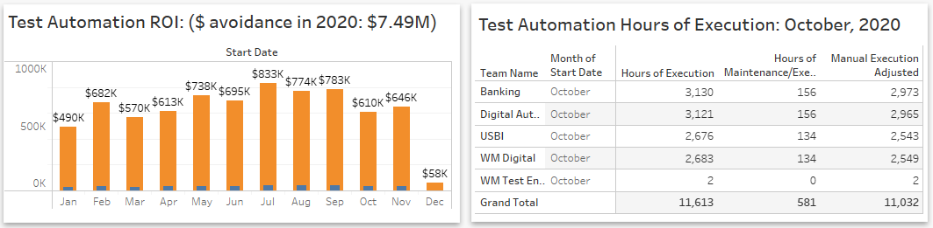
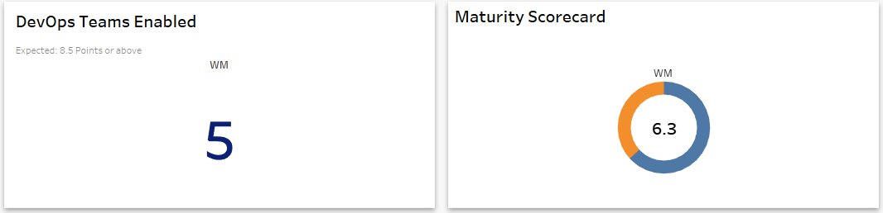
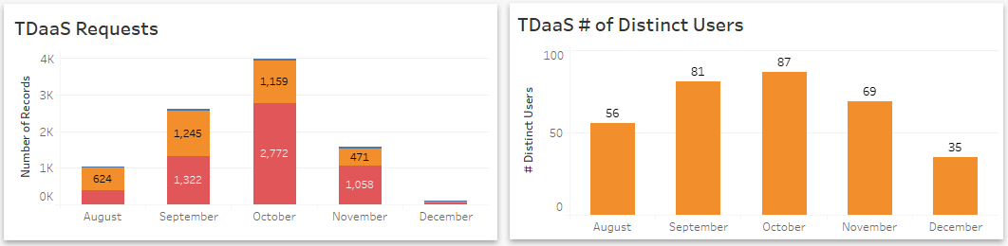
Test Automation
DevOps
Test Data

Slide 18

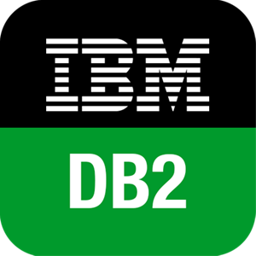



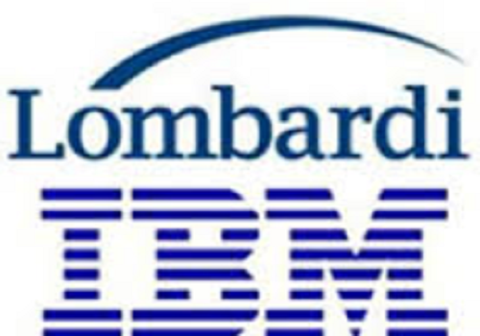




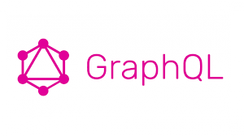
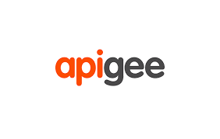
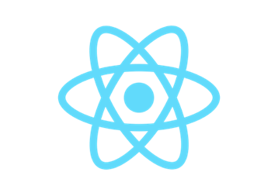

Evolution of Wealth Management Technology Landscape
2015
2020
2010
Past and Current State
Future State
Use Case Specific Software
Vendor Dependent
Too many silos
Monolithic Core Systems
Re-usable, modular shared services
Unified data platform accessible through APIs
Streamlined Core Systems

Slide 19
Key Focus Areas within Wealth Management
U.S Bank Current State
Wealth Management Focus Areas
Re-usable and Modular Shared Services
Modular and Shared Services
Modernize UI/UX Technologies
DevOps
Cloud Readiness
Service Mesh
Path forward to Enterprise DevOps
Separation of Concerns – Experience and Data
Prepare for Multi-Cloud Deployment
Configuration Service
Data Platform
Which NoSQL solution to choose?
Identify Data Workloads for Private Cloud
Unified Data Platform
Key Focus Areas
Cloud and DevOps Foundation
Streamlined Core Systems
Indicates Current State Progress
Source: Tech Modernization Pitch Deck

Slide 20
Modernize UI/UX Technologies
Where we are now…
Where we want to go ….
Diverse UI/UX Technologies
Angular, React and Proprietary Technologies across different products
Tightly coupled UI/UX with business logic in some products
Unified UI/UX Layer based on Shield standards
Decoupled UI/UX layer separated from business logic
Device agnostic codebase
How can we get there?
Slowly migrate to React UI using Strangler Pattern
Embed React and Shield components in existing pages
Decouple UI/UX Layer from business logic by using Experience APIs for data binding

Slide 21
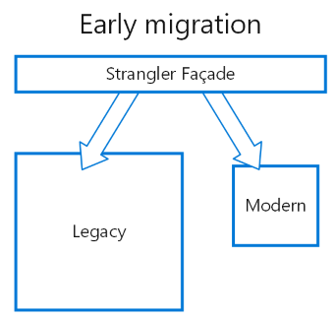
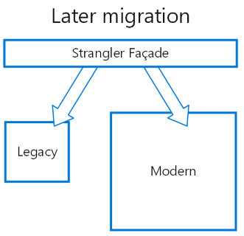

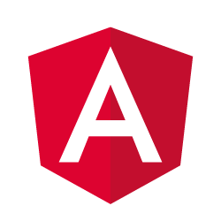
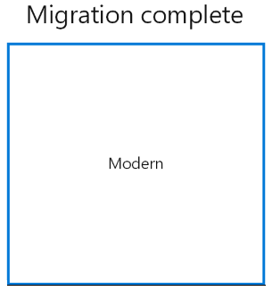
Adoption approaches for React in UI/UX applications
Slowly migrate to React UI using Strangler Pattern
Strangler Pattern is a well-known design pattern of decomposing existing systems and standing up new functionality, while both existing side-by-side.
Originally made popular by Martin Fowler
This pattern involves 4 easy steps:
  Identify: Parts of system to migrate
  Transform: Identified parts to new technology
  Co-Exist: Re-route calls from old system to new
  Eliminate: Repeat first three steps until migration is complete, and remove the old system
Source: Azure Architecture: Strangler Pattern

Slide 22
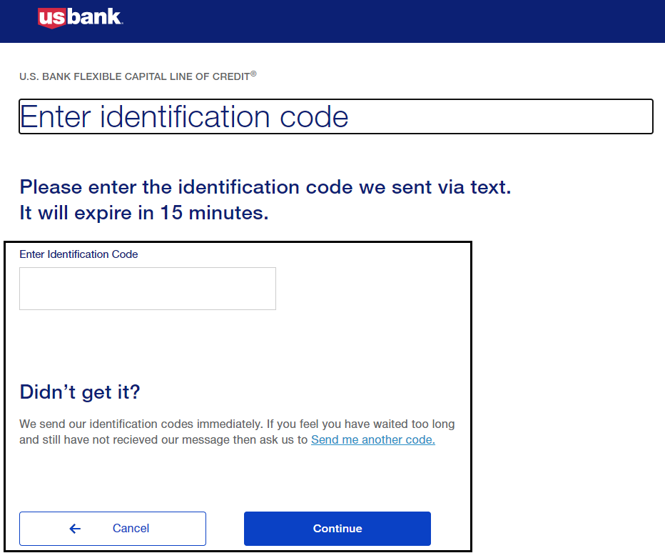
Adoption approaches for React in UI/UX applications
Embed React Widgets in existing pages
React widgets are fairly light-weight and can be easily embedded in web pages written in Angular or other JavaScript based frameworks.
Several shared services have provided how-to instructions and examples and plenty of resources available in the web.
Adjacent example shows Challenge Widget from SharedAuth team written in React embedded in an Angular page.

Slide 23
Separation of Concerns – Experience and Data
Where we’re now ….
Where we want to go …
Some applications with UI/UX separated out from domain/data layer.
Domain and experience layer combined in several applications.
Some applications still tightly coupled with database and data layer
Separated experience layer and domain layer
Build re-usable, modular shared services
Use SpringBoot and GraphQL where needed
How can we get there?
Avoid duplication of code, extract common code to create re-usable libraries or services
Identify GraphQL use cases and separate out the experience layer from backend systems with GraphQL driven services.

Slide 24
Transition to Modular and/or Shared Services
Separate Experience from Domain and Data Layer(s) where possible ….
A path forward to “Breaking the Monolith”
Promotes separation of concerns and makes systems “less resistant” to changes in requirements and demands.
Each layer can be scaled horizontally based on demands.

Slide 25
Transition to Modular and/or Shared Services
What is GraphQL?
A possible use-case …
GraphQL is schema and type driven query language for client-facing (UX or API consumers) applications.
Provides a level of abstraction from underlying data access layer. Provides an API to present data to the client based on model specified in schema.
Good fit for complex systems or microservices, by integrating multiple systems behind its API, unifies them and hides their complexity.
Relevant for legacy infrastructures or third-party APIs that have expanded over the years and now present a maintenance burden.
GraphQL API can help handle communication between multiple microservices by merging them into one GraphQL schema.

Slide 26
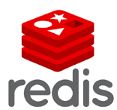






Modernize Data Platform(s) – Which NoSQL solution will work for me?
Types of NoSQL DBs – NOT “One size fits all”
CAP Theorem – “You can only pick two” !
Graph Databases
Entities and relationships stored as nodes and edges of a graph
Each node and edge can be uniquely identified
Deletion of a node not possible without deleting associated relationship(s)
Mostly used in social-networking platforms
Statement: “It is impossible for a distributed data store to simultaneously provide more than two out of the following three guarantees (Consistency, Availability and Partition Tolerance)”
Consistency: Every read receives the most recent write or error.
Availability: Every node (if not failed) always receives a response.
Partition Tolerance: The system continues to operate, even if the connections between nodes are down (network issues).
“Partition tolerance is difficult to achieve for traditional RDBMS”
Key-Value Store
Data stored in key-value pairs
Can handle large volumes and heavy loads
Can store binary data and large objects
Behaves like Hash Map.
Column Family Based
Uses a concept called keyspace similar to database schema.
Keyspaces contain one or more column families
Optimized for handling large datasets and aggregation queries
Updates are inefficient..
Document Database
Data stored as key and complex data like XML, JSON etc. as values.
Supports query and aggregate operations.
Supports indexing
Data model is designed as per nature of queries, not driven by type of data to be stored.

Slide 27
Modernize Data Platform(s) – Identify Some Data Workloads for Private Cloud
Most of the data integrations within Wealth Management rely on ELZ, Informatica, File Shares (Windows/UNIX) and MFS.
Data processing workloads heavily rely on-prem infrastructure.
Most workloads are batch process oriented.
We can start looking at certain file processing workloads that feeds the staging data and convert those to containerized workloads.
Let’s take one of the example below …
Current State: File Processing ETL example
Future State: Containerized Workload for Files
On-Prem
Private Cloud

Slide 28
Path forward to Enterprise DevOps
Where we’re now ….
Where we want to go …
Two parallel DevOps pipelines available in the bank.
  USB Jenkins by Cloud Platform Solutions
  CloudBees Jenkins by Enterprise DevOps
Most projects in Wealth use USB Jenkins pipeline
Some projects planning to use CloudBees tools for 2021 CapEx’s
All projects should be using EDSE CI/CD pipeline.
All projects should be capable of multi-cloud deployments.
All projects should have Pipeline-as-Code with Jenkinsfile replacing Jenkins jobs
Environmental configurations of Kubernetes should also be part of the codebase
How can we get there?
CPS Team started supporting EDSE tools and Jenkinsfile based deployment.
  CPS Demo Recording
  Couldbees Onboarding information
EDSE Enterprise Pipeline Toolkit
CPS Self-Service tool is supporting multi-cloud deployments through Rancher

Slide 29


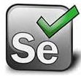











DevOps and CI/CD – Who owns what today ….
Code
Merge
Build
Test
Deploy
Run
Metrics
Archive
Govern
Scan
CPS Pipeline
EDSE Pipeline
Product
Team(s)
EDSE
CPS
CM/ISS/Ops

Slide 30
Cloud Readiness – Configuration Service
Current State – Embedded Configurations
Future State – Externalized Configurations
Most applications use configuration artifacts (database connections, service URL’s, credentials etc.) to communicate to external and internal resources. Typically, these configuration artifacts remain embedded and distributed across the codebase, which makes software hard to maintain and incurs code debt.
In modern world of cloud computing, it is a generally accepted best practice to externalize all the configuration, including endpoint URLs and credentials. The application should load them either at startup or on the fly. These can be accessed by the application on startup or can be refreshed without a server restart. This avoids duplication of code and improves maintainability.
Consider looking into spring-cloud-config, spring-cloud-Netflix for reference implementations.

Slide 31
References
Microservice Architecture and Design Patterns
https://dzone.com/articles/design-patterns-for-microservices
https://martinfowler.com/bliki/StranglerFigApplication.html
https://dzone.com/articles/monolith-to-microservices-using-the-strangler-patt
GraphQL
https://graphql.org/
https://dzone.com/articles/graphql-core-features-architecture-pros-and-cons
NoSQL and CAP Theorem
https://medium.com/swlh/4-types-of-nosql-databases-d88ad21f7d3b
https://dzone.com/articles/understanding-the-cap-theorem
Configuration Service
https://dzone.com/articles/microservices-and-spring-cloud-config-server
https://github.com/Netflix/archaius
https://engineering.pivotal.io/post/local-eureka-zuul-cloud_config-with-spring/

